Slide 1
Collections and Generics
Chapter - 12

Slide 2
Ref : https://www.youtube.com/watch?v=ecbv4bsxkvk

Slide 3
What are Generics/Need for Generics
A primary limitation of collections is the absence of effective type checking. This means that you can put any object in a collection because all classes in the C# programming language extend from the object base class. This compromises type safety and contradicts the basic definition of C# as a type-safe language. In addition, using collections involves a significant performance overhead in the form of implicit and explicit type casting that is required to add or retrieve objects from a collection.
Generics ( a class ) in C# is its most powerful feature. It allows you to define the type-safe data structures.
The basic idea behind using Generics is to allow type (Integer, String, … etc., and user-defined types) to be used as a parameter to methods, classes, and interfaces.

Slide 4
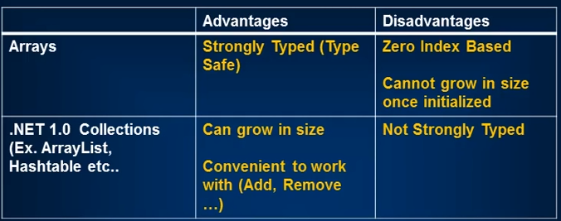
What are Generics/Need for Generics

Slide 5
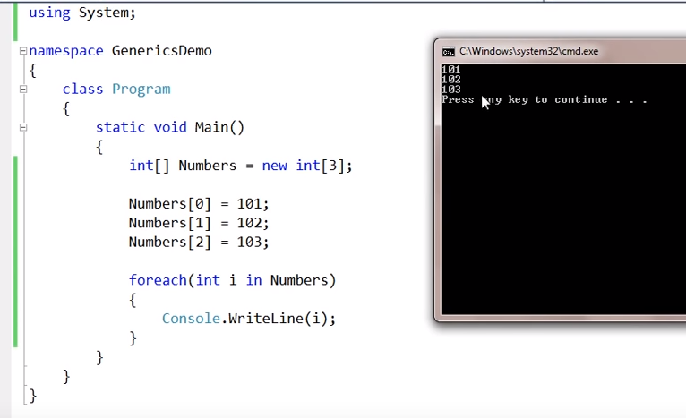
Working with Arrays

Slide 6

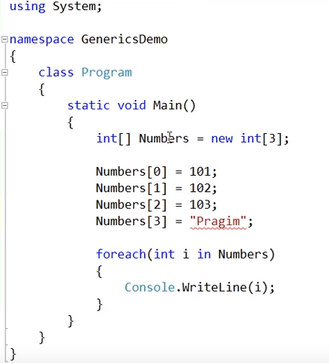
Strongly typed

Slide 7
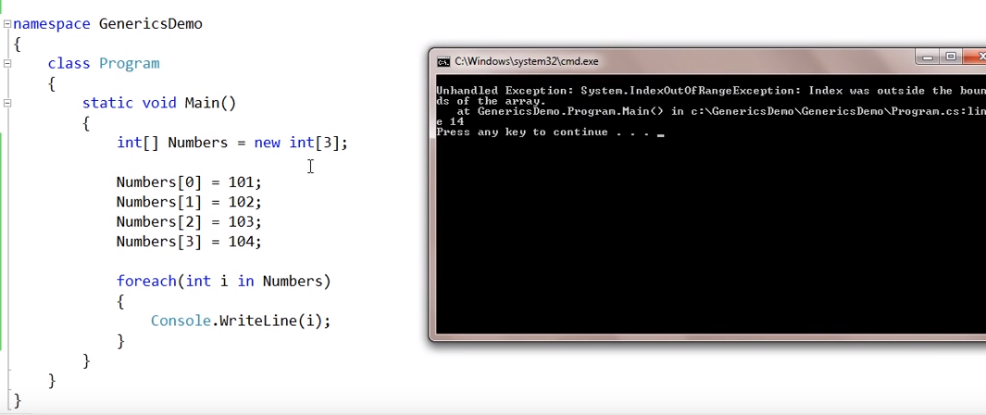
Arrays – cannot grow in size

Slide 8
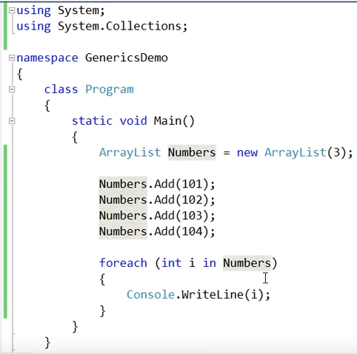
Using Collections 1.0 – can grow in size

Slide 9
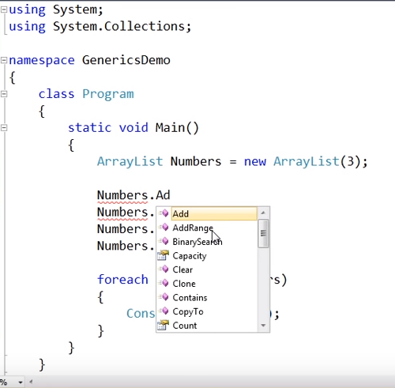
Uses range of methods to work with

Slide 10
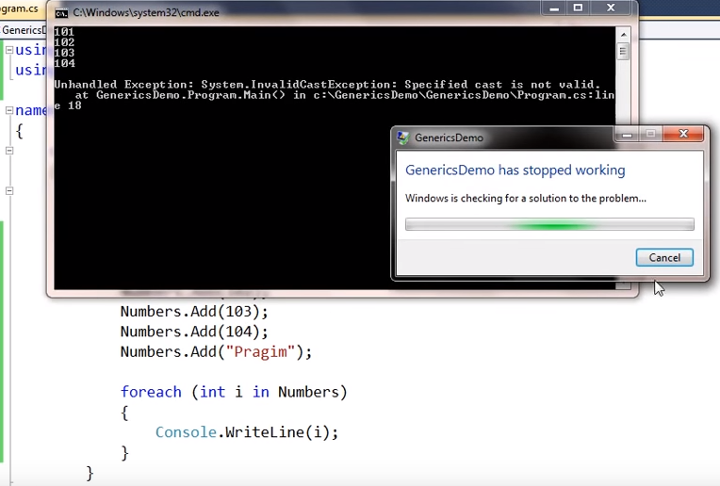
Adding another datatype – not strongly data -typed

Slide 11
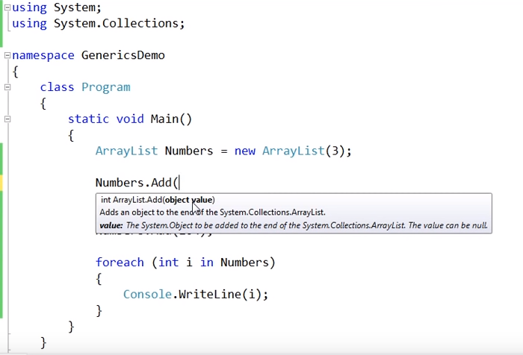
Boxing and unboxing – unwanted overhead

Slide 12
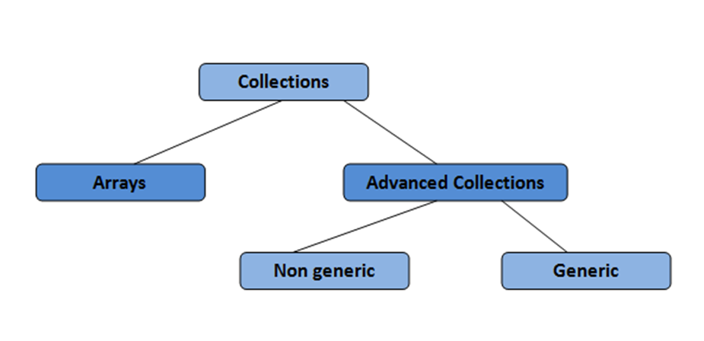
Collections
A collection is a set of similar type of objects that are grouped together.
System.Collections namespace contains specialized classes for storing and accessing the data.
Collections can contain mainly two types:
Arrays
Advanced Collections
Non Generic
Generic

Slide 13
Generic collections and non-generic collections
Generic collections were added in the .NET Framework 2.0 and provide collections that are type-safe at compile time.
Because of this, generic collections typically offer better performance. Generic collections accept a type parameter when they are constructed and do not require that you cast to and from the Object type when you add or remove items from the collection.
Non-generic collections store items as Object, require casting. However, you may see non-generic collections in older code.

Slide 14
Generics has best of both the worlds
Type safe like arrays
Grow automatically in sizes like arrayList
Has a range of convinient methods to work with like Add, Remove etc.,
Generic collections typically offer better performance as they do not require casting.

Slide 15
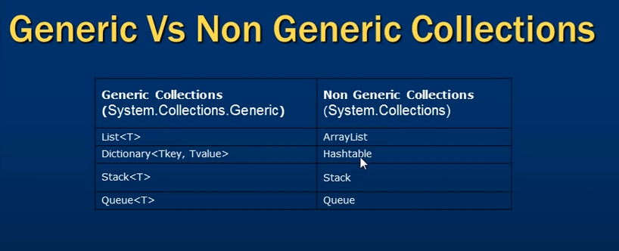

Slide 16
Lists

Slide 17
What are Lists ?
A list is a collection of items that can be accessed by index and provides functionality to search, sort and manipulate list items.
The List<T> class defined in the System.Collections.Generic namespace is a generic class and can store any data types to create a list. Before you use the List class in your code, you must import the System.Collections.Generic namespace using the following line.
using System.Collections.Generic;

Slide 18
The C# List<T> Object
List<T> class in C# represents a strongly typed list of objects. List<T> provides functionality to create a list of objects, find list items, sort list, search list, and manipulate list items.
In List<T>, T is the type of elements in the list.

Slide 19
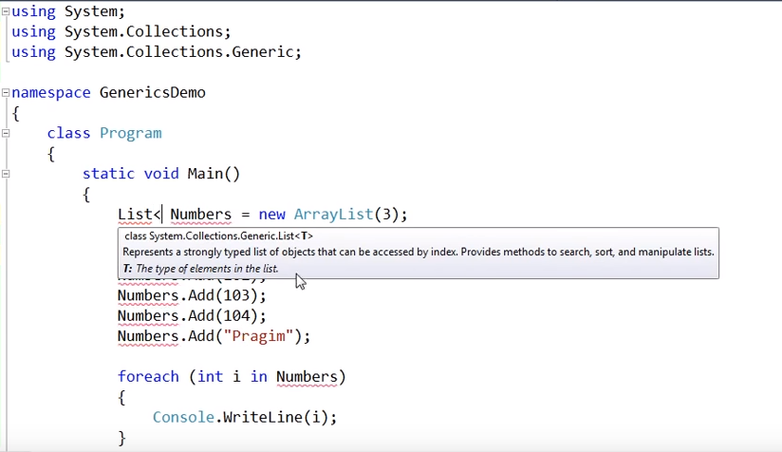
Using List<T>

Slide 20
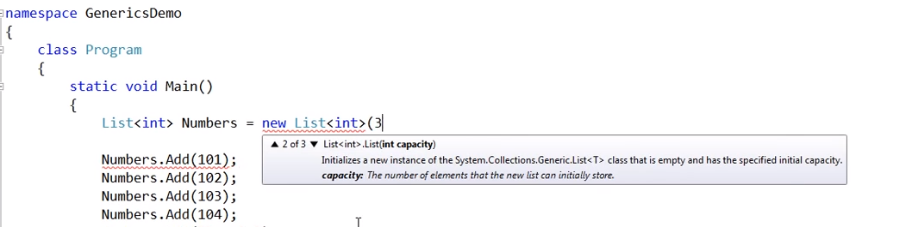
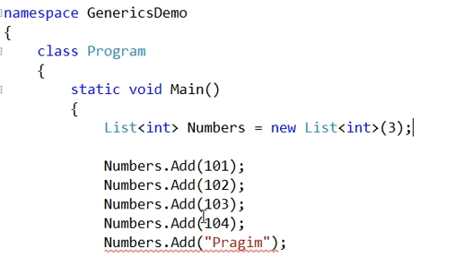
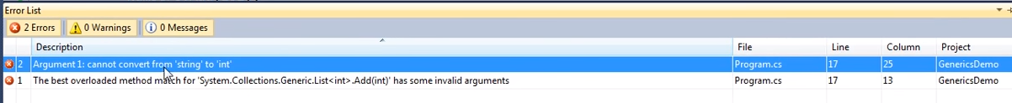
Strongly typed

Slide 21
Creating List<T> object
List<T> class constructor is used to create a List object of type T. It can either be empty or take an Integer value as an argument that defines the initial size of the list, also known as capacity.
If there is no integer passed in the constructor, the size of the list is dynamic and grows every time an item is added to the array. You can also pass an initial collection of elements when initializing an object.
Notes:
Capacity of empty list is 0. If one element is added capacity becomes 4. If 5th element is added to the list capacity becomes 8 and so on…

Slide 22
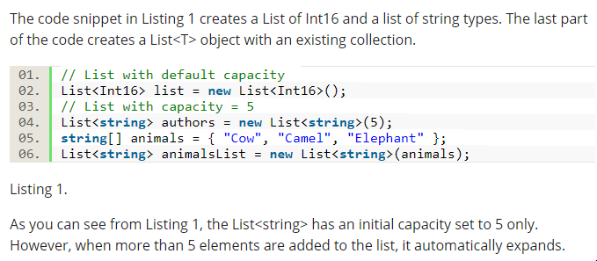

Slide 23
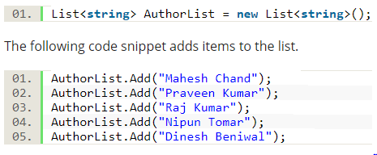
Adding items to a List
The following code snippet creates a List of string types and adds items to it.

Slide 24
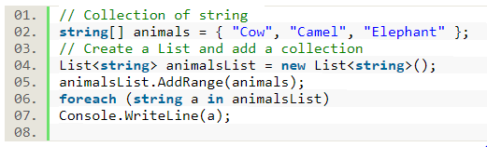
AddRange()
The AddRange method is used to add a collection to a List. The code snippet adds an array of strings to a List.

Slide 25
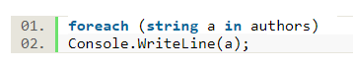
Reading from a List
We can use a foreach loop to loop through its items. The code snippet reads all items of a List and displays on the console.
To retrieve an item at a specific position in the List, we can use the collection’s index. The following code snippet reads the 3rd item in the List.
Console.WriteLine(authors[2])

Slide 26
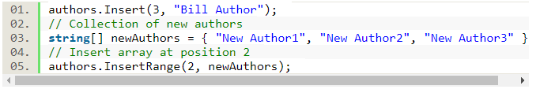
Insert Items at a Position in a C# List
The Insert method of List class inserts an object at a given position. The first parameter of the method is the 0th based index in the List.
The InsertRange method can insert a collection at the given position.
The code snippet below inserts a string at the 3rd position and an array at the 2nd position of the List<T>.

Slide 27
Remove Items of a C# List
The List class provides Remove methods that can be used to remove an item or a range of items.
The Remove method removes the first occurrence of the given item in the List. The following code snippet removes the first occurrence of ‘New Author1’.

Slide 28
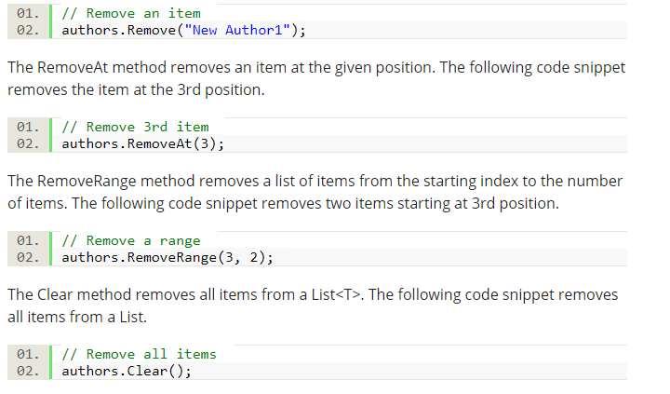

Slide 29
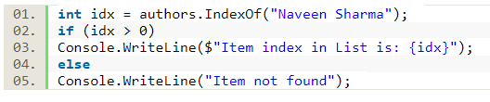
Find an Item in a C# List
The IndexOf method finds an item in a List. The IndexOf method returns -1 if there are no items found in the List.
The following code snippet finds a string and returns the matched position of the item.

Slide 30
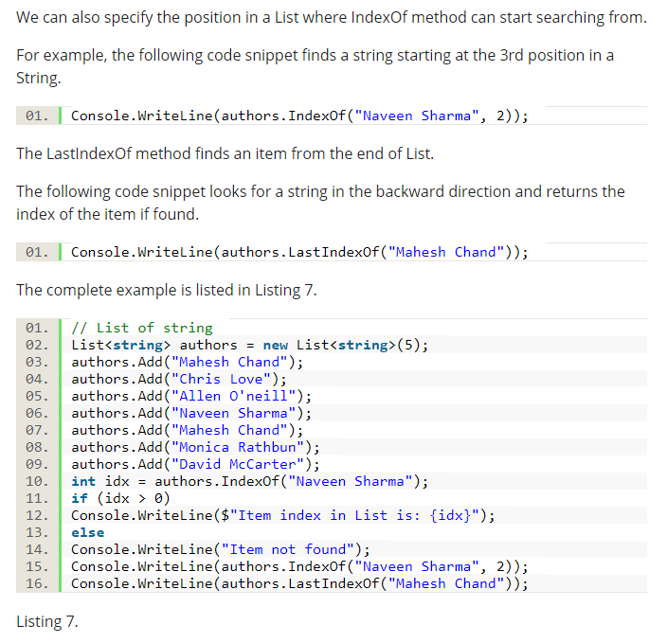

Slide 31
Sort a C# List Items
The Sort method of List<T> sorts all items of the List using the QuickSort algorithm.
The following code example in Listing 8 sorts a List items and displays both original order and sorted order of the List items.

Slide 32
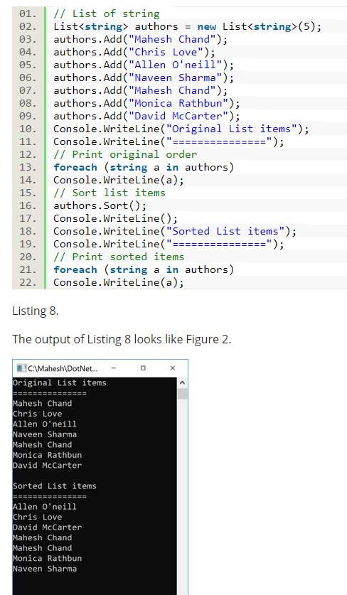
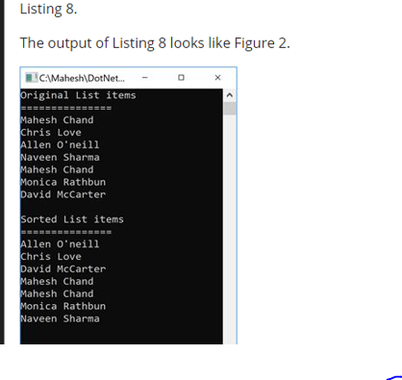

Slide 33
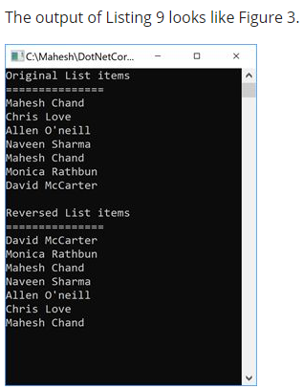
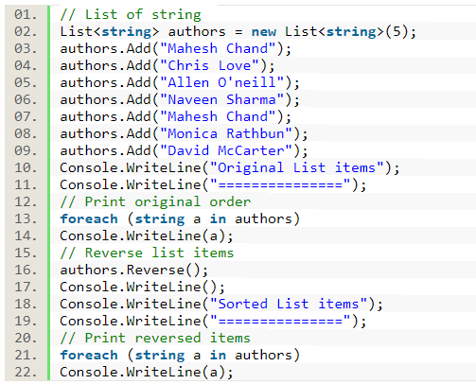
Reverse an ArrayList
The Reverse method of List<T> reverses the order all items in in the List.
The following code snippet reverses a List.

Slide 34
Search a C# List
The BinarySearch method of List<T> searches a sorted list and returns the index of the found item. The List<T> must be sorted before this method can be used.
The following code snippet returns an index of a string in a List.
int bs = authors.BinarySearch("Mahesh Chand");

Slide 35
Queue

Slide 36
Generic queue collection class
Queue is a generic FIFO (First In First Out) collection class that is present in System.Collections.Generic namespace.
The Queue collection class is analogous to a queue at the ATM machine to withdraw money. The order in which people queue up, will be the order in which they will be able to get out of the queue and withdraw money from the ATM. The Queue collection class operates in a similar fashion.
The first item to be added (enqueued) to the queue, will be the first item to be removed (dequeued) from the Queue.

Slide 37
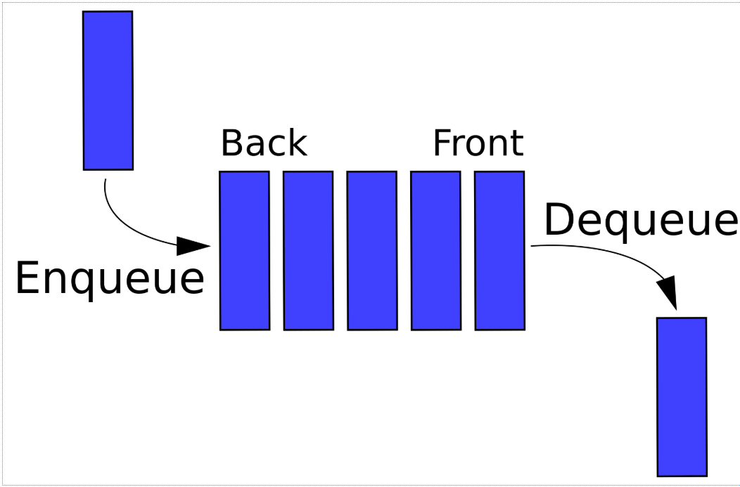

Slide 38
Common Methods in Collection Queue
To add items to the end of the queue, use Enqueue() method.
To remove an item that is present at the beginning of the queue, use Dequeue() method.
A foreach loop iterates thru the items in the queue, but will not remove them from the queue.
Peek() returns the item at the beginning of the queue, without removing it.
To check if an item, exists in the queue, use Contains() method.

Slide 39
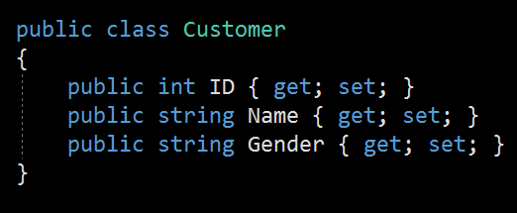
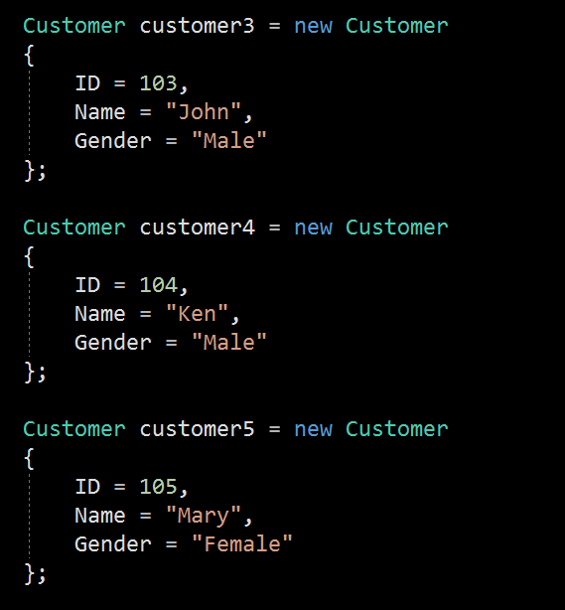
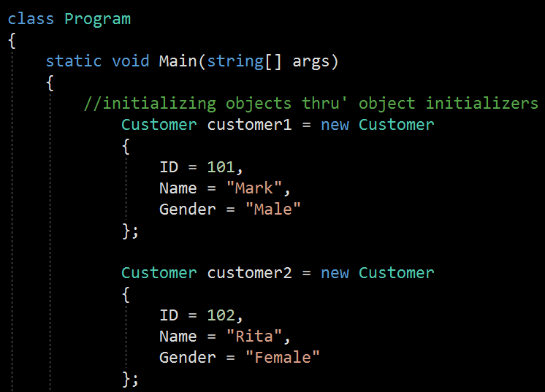
1
3
2

Slide 40
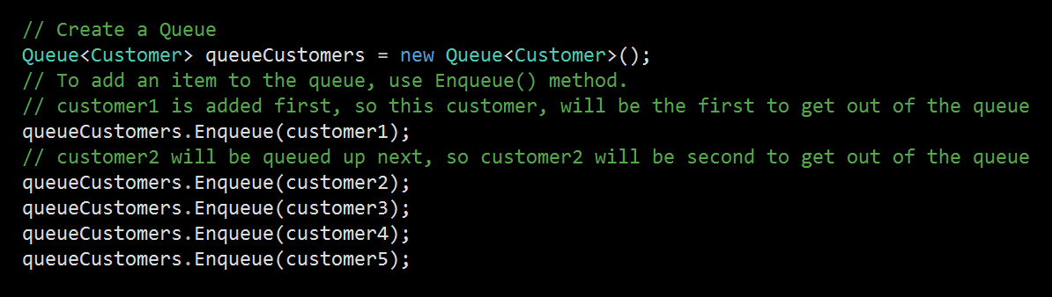
Creating a Queue and adding items onto the queue

Slide 41
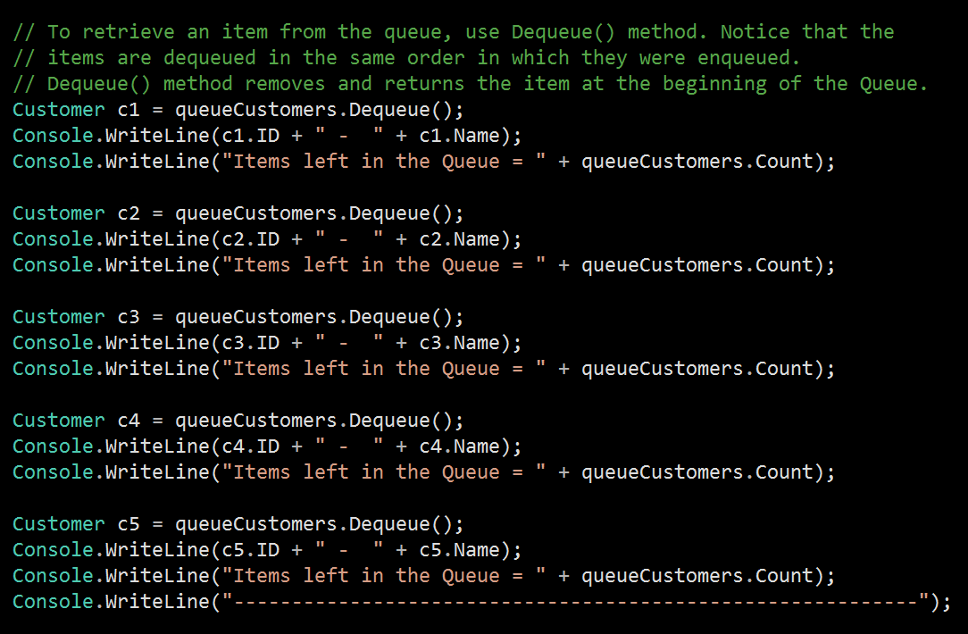
Retrieve an item from the queue

Slide 42
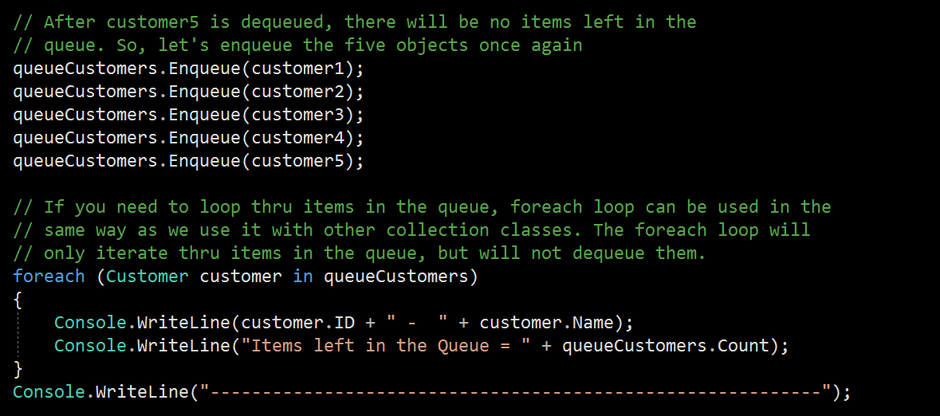
Using a foreach loop to iterate thru’ the queue

Slide 43
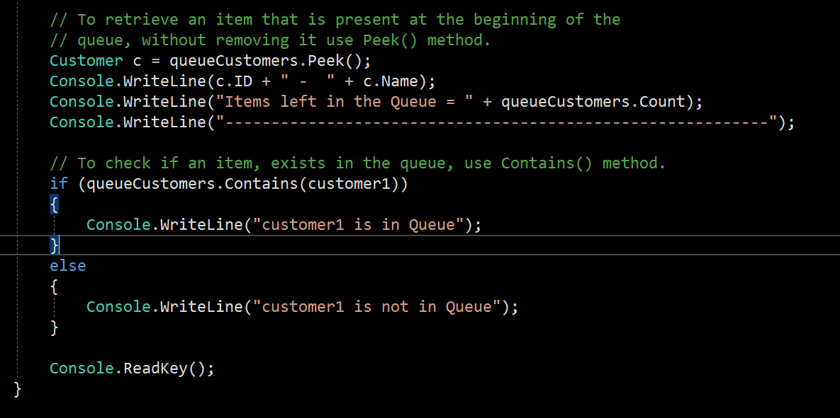
Using the Peek() and the Contains() methods

Slide 44
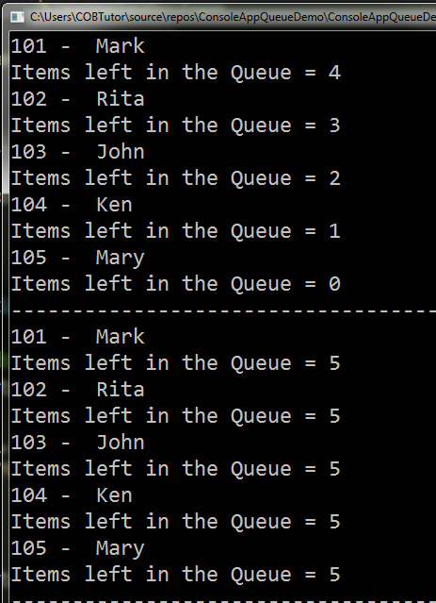
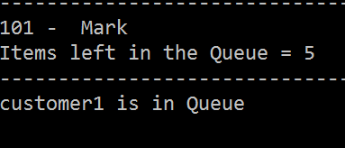
output

Slide 45
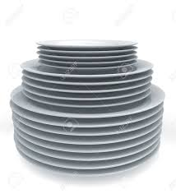
Stacks

Slide 46
Stack
Stack is a generic LIFO (Last In First Out) collection class that is present in System.Collections.Generic namespace.
The Stack collection class is analogous to a stack of plates. If you want to add a new plate to the stack of plates, you place it on top of all the already existing plates. If you want to remove a plate from the stack, you will first remove the one that you have last added.
The stack collection class also operates in a similar fashion. The last item to be added (pushed) to the stack, will be the first item to be removed (popped) from the stack.

Slide 47
Some methods in the stack class
To insert an item at the top of the stack, use Push() method.
To remove and return the item that is present at the top of the stack, use Pop() method.
A foreach loop iterates thru the items in the stack, but will not remove them from the stack. The items from the stack are retrieved in LIFO (Last In First Out), order. The last element added to the Stack is the first one to be removed.
To check if an item exists in the stack, use Contains() method.
What is the difference between Pop() and Peek() methods? Pop() method removes and returns the item at the top of the stack, where as Peek() returns the item at the top of the stack, without removing it.

Slide 48
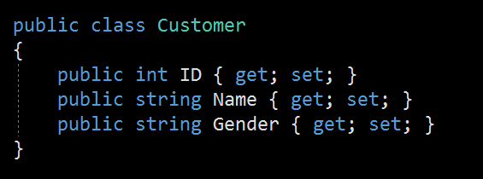
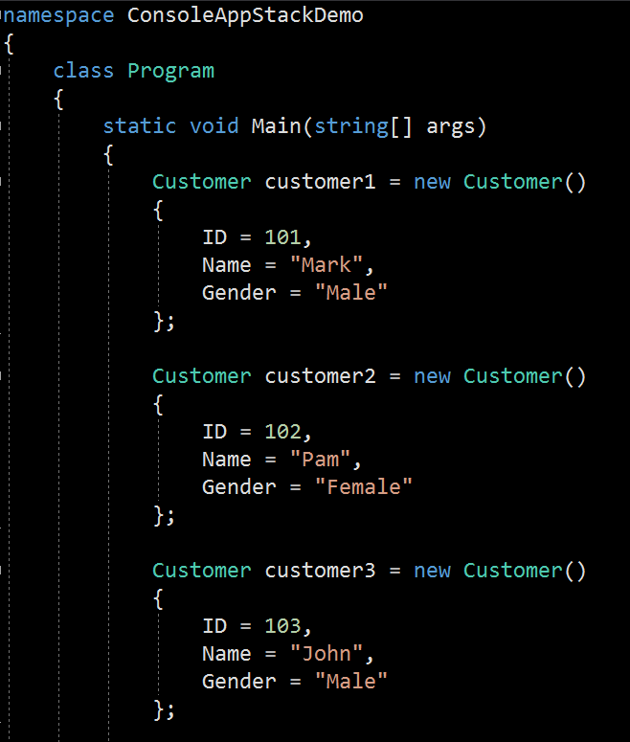
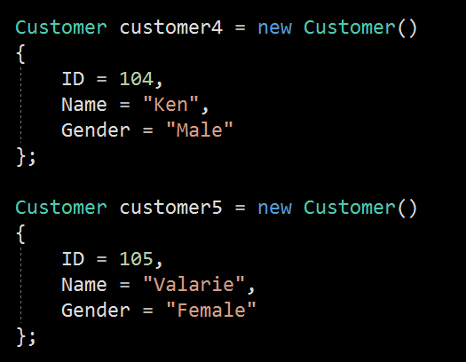
1
2
3

Slide 49
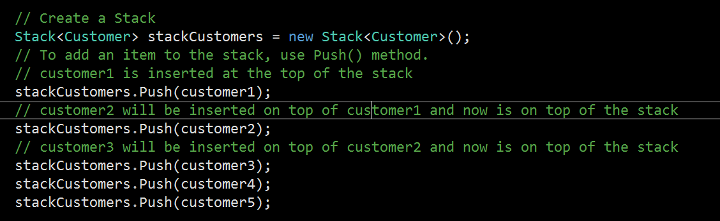
Create a stack and Push items onto it

Slide 50
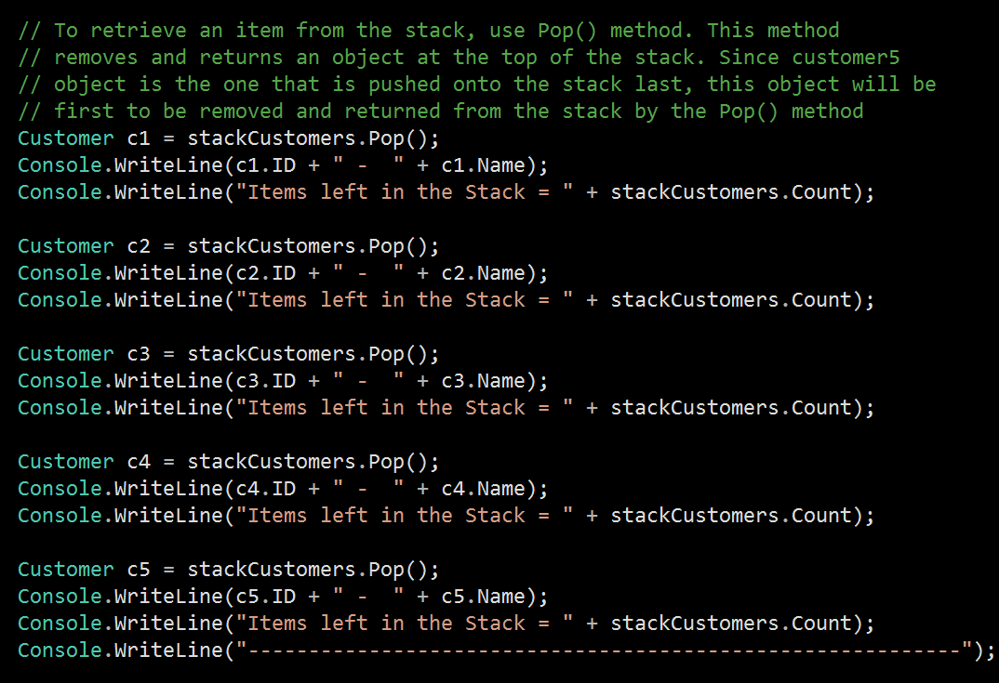
Using the Pop()

Slide 51
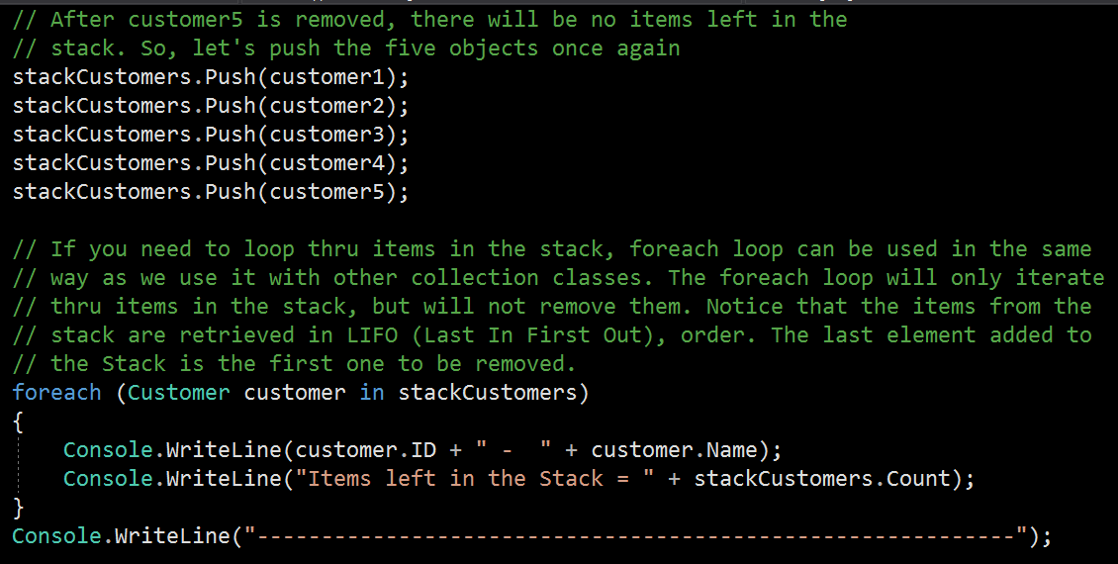
Using Push() and foreach to get the items from the stack

Slide 52
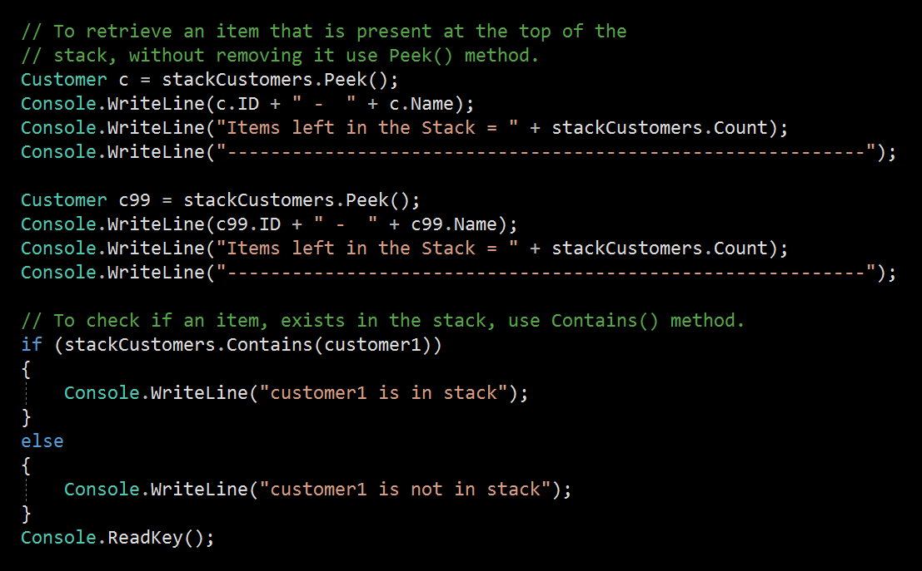
Using the Peek() and the Contains() method

Slide 53
Dictionary

Slide 54
What is a Dictionary
English dictionary is a collection of words and their definitions, often listed alphabetically in one or more specific languages. In the same way, the Dictionary in C# is a collection of Keys and Values, where key is like word and value is like definition.
The Dictionary<TKey, TValue> class is a generic collection class in the System.Collection.Generics namespace. TKey denotes the type of key and TValue is the type of TValue.
The Dictionary class constructor takes a key data type and a value data type. Both types are generic so it can be any .NET data type.

Slide 55
What is a Dictionary
1. A dictionary is a collection of (key, value) pairs.
2. Dictionary class is present in System.Collections.Generic namespace.
3. When creating a dictionary, we need to specify the type for key and value.
4. Dictionary provides fast lookups for values using keys.
5. Keys in the dictionary must be unique.

Slide 56
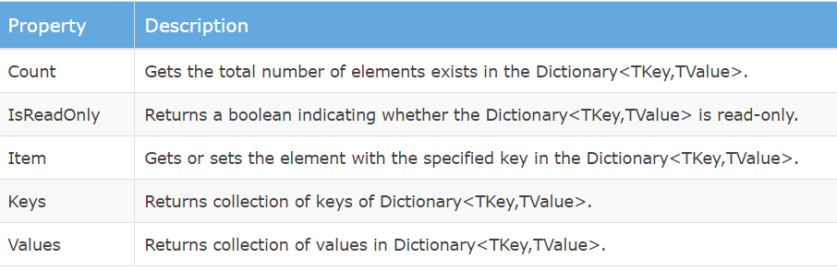
Important properties of Dictionary

Slide 57
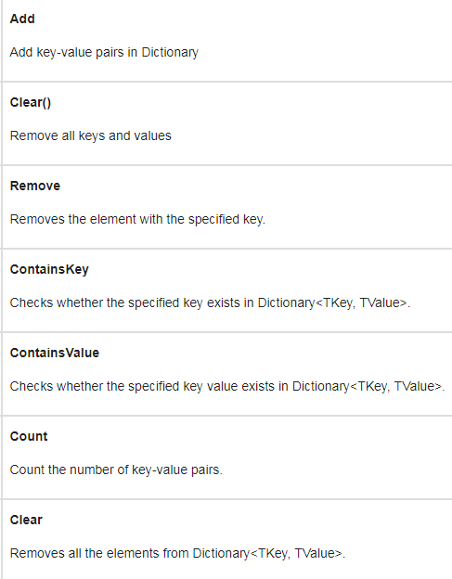
Important Methods of Dictionary

Slide 58
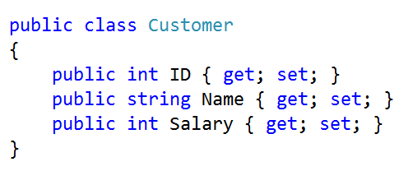
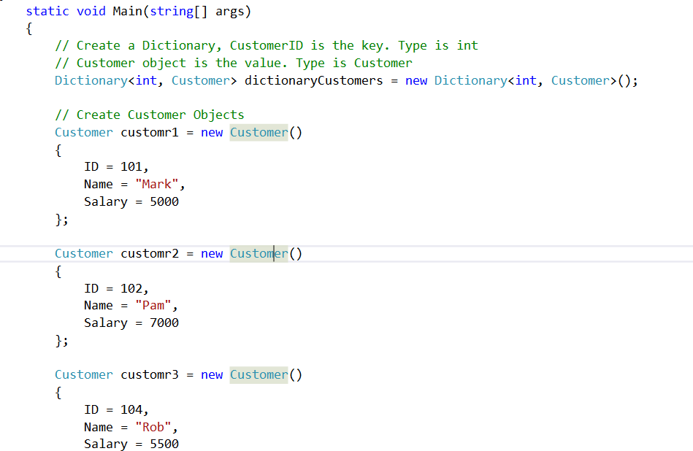
1
2

Slide 59
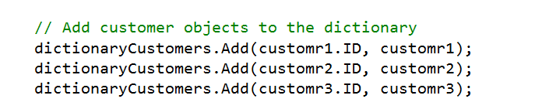
Add Elements into Dictionary
Use Add() method to add the key-value pair in dictionary.
Add() Signature: void Add(TKey, Tvalue)

Slide 60
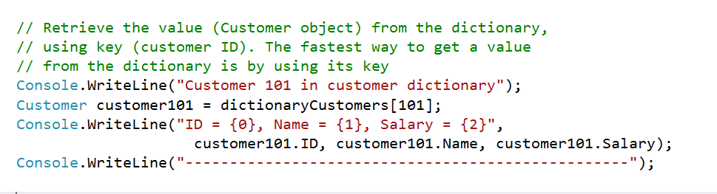
Accessing Dictionary Elements

Slide 61



Slide 62


Slide 63


Slide 64


Slide 65


Slide 66


Slide 67


Slide 68


Slide 69




Slide 70
Linked Lists

Slide 71

What is a Linked List?
Linked List is a linear data structure which consists of a group of nodes in a sequence. Each node contains two parts.
Data− Each node of a linked list can store a data.
Address − Each node of a linked list contains an address to the next node, called "Next".

Slide 72
Linked List
The first node of the list is called the head node.
Using the link in the head node, you can get to the next node and continue traversing nodes until the final link is a null value.
Often, the term tail is used to refer to the list pointed to by the head node—that is, it refers to everything after the head node.

Slide 73

Common operations
A linked list supports the following common operations:
Add: Adding or inserting an item in a linked list is a matter of changing links, as shown in Figure.
Say you want to insert a new node (with value Z) between the nodes with values A and B. First, you need to allocate memory for the new node and assign value Z to the data section of the node. Next, you must copy the link section of node A to the link section of node Z so that node Z is pointing to node B. Finally, you must copy the address of the newly created node Z to the link section of node A so that node A starts pointing to node Z.

Slide 74

Common operations
Remove: Similar to the add operation, the remove or delete operation is also a matter of changing links. For example, to delete the third node in Figure , you would change the link for the second node to a null value. The third node will now be an unreferenced piece of memory, and it will eventually be returned to the pool of available memory.
Find: The find operation finds a node with a given value in the linked list. To find a value, you generally start from the head node and check whether the value matches. If not, you follow the link to the next node and continue the find operation until you reach the end of the list, which happens when you encounter a null link.

Slide 75
PERFORMANCE AND USAGE
A linked list does not allow random access to its items. The only way to get to an item is to start from the head node and follow the links from there. As a result, linked lists are slow at retrieving data.
However, for insert and delete operations, linked lists are extremely fast, because insertion or deletion of a node involves simply changing a link.
In fact, a linked list provides an alternative way to implement the queue and the stack data structures. If your requirements call for frequent access to data but you seldom need to insert or delete data, an array is the preferred implementation. If, however, your requirements call for frequent insert and delete operations, then a linked list may be a better implementation.

Slide 76

Types of Linked List - Singly Linked List
Singly Linked List: Singly linked lists contain nodes which have a data part and an address part, i.e., Next, which points to the next node in the sequence of nodes. The next pointer of the last node will point to null.

Slide 77

Doubly Linked List
In a doubly linked list, each node contains two links - the first link points to the previous node and the next link points to the next node in the sequence.
The prev pointer of the first node and next pointer of the last node will point to null.
The .NET Framework provides a LinkedList class as part of the System.Collections.Generic namespace. This class implements a homogeneous doubly linked list of the specified data type.

Slide 78

Circular Linked List:
Circular Linked List: In the circular linked list, the next of the last node will point to the first node, thus forming a circular chain.

Slide 79

Doubly Circular Linked List
Doubly Circular Linked List: In this type of linked list, the next of the last node will point to the first node and the previous pointer of the first node will point to the last node.

